Slide 1

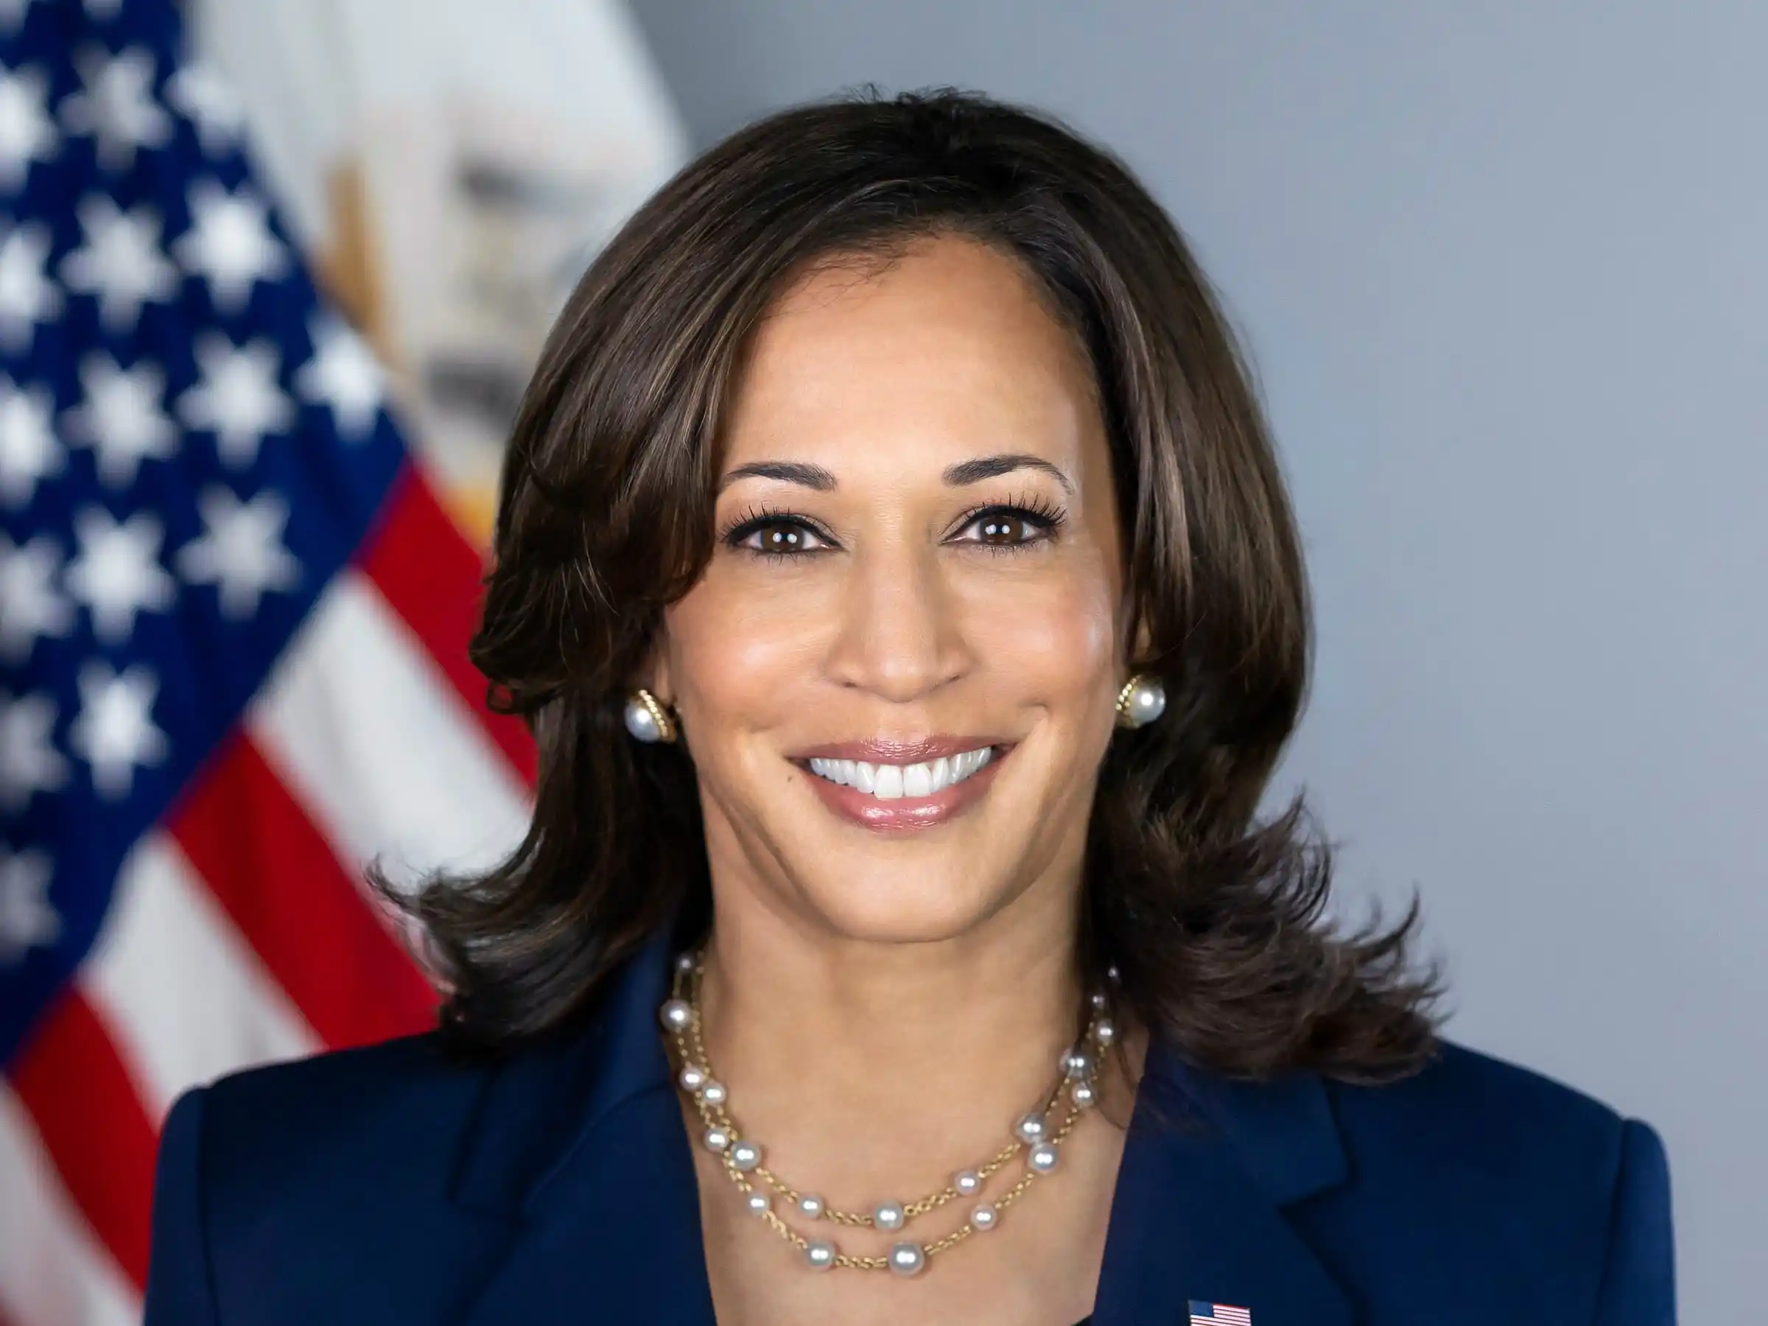
How Well Do You Know
Kamala Harris?
Kamala Harris is the Vice President of the United States, serving since 2021. Previously, she was a U.S. Senator from California (2017-2021) and the Attorney General of California (2011-2017). She is known for her advocacy on issues such as immigration, healthcare, and social justice. Born in Oakland, California, Harris is the first female, first Black, and first Asian-American Vice President. She is a graduate of Howard University and UC Hastings College of the Law.

Slide 2
1. Who was Kamala Harris's running mate in the 2020 U.S. Presidential Election?
[A] Pete Buttigieg
[B] Joe Biden
[C] Bernie Sanders
[D] Elizabeth Warren

Slide 3
2. Where did Kamala Harris' mother pursue her PhD?
[A] Stanford University
[B] Harvard University
[C] University of Delhi
[D] University of California, Berkeley

Slide 4
3. Who is Kamala Harris married to?
[A] Willie Brown
[B] Douglas Emhoff
[C] Gavin Newsom
[D] Tony West

Slide 5
4. What is Kamala Harris' position on LGBTQ+ rights?
[A] Strongly supports LGBTQ+ rights
[B] Has not stated a clear position
[C] Opposes same-sex marriage
[D] Believes in limiting LGBTQ+ rights

Slide 6
5. What is Kamala Harris' stance on climate change?
[A] Supports aggressive climate action
[B] Prefers no government intervention
[C] Thinks it's not a priority
[D] Believes it's a hoax

Slide 7
6. What is Kamala Harris' tie-breaking role in the Senate?
[A] Minority Leader
[B] Chairperson
[C] Majority Leader
[D] President of the Senate

Slide 8
7. What is the name of Kamala Harris's first book?
[A] Smart on Crime
[B] The Truths We Hold
[C] The Audacity of Hope
[D] Dreams from My Father

Slide 9
8. What is Kamala Harris' sister's name?
[A] Leela Harris
[B] Sara Harris
[C] Maya Harris
[D] Nina Harris

Slide 10
9. Which case did Kamala Harris refuse to defend as California Attorney General?
[A] Proposition 13
[B] Proposition 64
[C] Proposition 8
[D] Proposition 22

Slide 11
10. What was one of Kamala Harris's key initiatives as San Francisco District Attorney?
[A] Eliminating the homicide division
[B] Increasing penalties for misdemeanors
[C] Reducing funding for prosecutors
[D] Creating a Hate Crimes Unit

Slide 12
Thank YOU FOR PLAYING

Slide 13
ANSWER KEY
1. Who was Kamala Harris's running mate in the 2020 U.S. Presidential Election?
[B] Joe Biden
2. Where did Kamala Harris' mother pursue her PhD?
[D] University of California, Berkeley
3. Who is Kamala Harris married to?
[B] Douglas Emhoff
4. What is Kamala Harris' position on LGBTQ+ rights?
[A] Strongly supports LGBTQ+ rights
5. What is Kamala Harris' stance on climate change?
[A] Supports aggressive climate action
6. What is Kamala Harris' tie-breaking role in the Senate?
[D] President of the Senate
7. What is the name of Kamala Harris's first book?
[A] Smart on Crime
8. What is Kamala Harris' sister's name?
[C] Maya Harris
9. Which case did Kamala Harris refuse to defend as California Attorney General?
[C] Proposition 8
10. What was one of Kamala Harris's key initiatives as San Francisco District Attorney?
[D] Creating a Hate Crimes Unit

