Slide 1

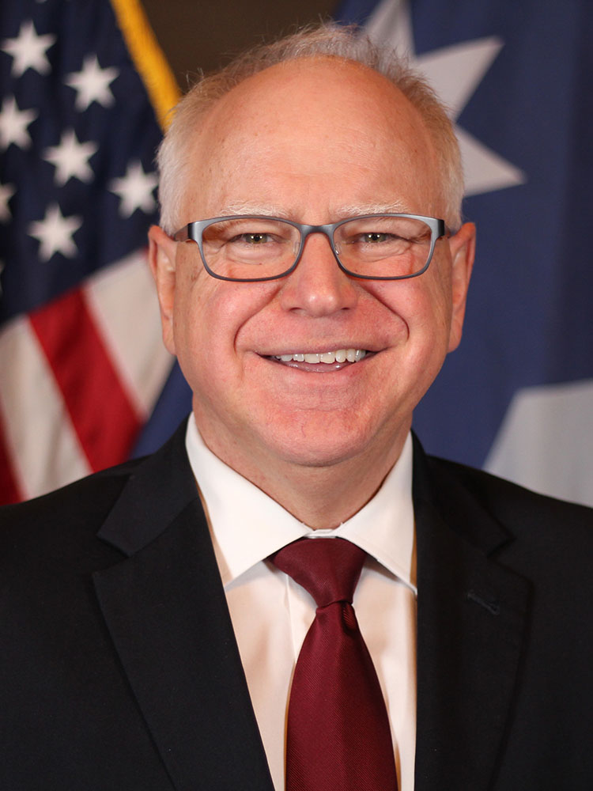
Get to know Tim Walz
Tim Walz is the current Governor of Minnesota, a position he has held since 2019. Prior to this, he served as a U.S. Representative for Minnesota's 1st congressional district from 2007 to 2019. Walz is a member of the Democratic–Farmer–Labor Party, an affiliate of the Democratic Party. He has focused on issues such as education, healthcare, and infrastructure during his political career.

Slide 2
1. In which branch of the military did Tim Walz serve?
[A] Marine Corps
[B] Air Force
[C] Army National Guard
[D] Navy

Slide 3
2. What is Tim Walz's favorite outdoor activity?
[A] Camping
[B] Gardening
[C] Hiking
[D] Fishing

Slide 4
3. Where did Tim Walz complete his undergraduate education?
[A] Harvard University
[B] Yale University
[C] Chadron State College
[D] University of Minnesota

Slide 5
4. Which state did Tim Walz represent in the U.S. Congress?
[A] Illinois
[B] Minnesota
[C] Nebraska
[D] Wisconsin

Slide 6
5. What is the name of Tim Walz's wife?
[A] Karen Walz
[B] Michelle Walz
[C] Melania Walz
[D] Gwen Walz

Slide 7
6. What was Tim Walz's first job?
[A] Lawyer
[B] Army National Guard
[C] Doctor
[D] Police officer

Slide 8
7. How many terms did Tim Walz serve in the U.S. House of Representatives?
[A] 2 terms
[B] 8 terms
[C] 6 terms
[D] 4 terms

Slide 9
8. How many children does Tim Walz have?
[A] 5
[B] 4
[C] 3
[D] 2

Slide 10
9. Where was Tim Walz born?
[A] Minneapolis, Minnesota
[B] Des Moines, Iowa
[C] West Point, Nebraska
[D] Chicago, Illinois

Slide 11
10. Where did Tim Walz attend college?
[A] Yale University
[B] Harvard University
[C] University of Minnesota
[D] Chadron State College

Slide 12
Thank YOU FOR PLAYING

Slide 13
ANSWER KEY
1. In which branch of the military did Tim Walz serve?
[C] Army National Guard
2. What is Tim Walz's favorite outdoor activity?
[D] Fishing
3. Where did Tim Walz complete his undergraduate education?
[C] Chadron State College
4. Which state did Tim Walz represent in the U.S. Congress?
[B] Minnesota
5. What is the name of Tim Walz's wife?
[D] Gwen Walz
6. What was Tim Walz's first job?
[B] Army National Guard
7. How many terms did Tim Walz serve in the U.S. House of Representatives?
[C] 6 terms
8. How many children does Tim Walz have?
[D] 2
9. Where was Tim Walz born?
[C] West Point, Nebraska
10. Where did Tim Walz attend college?
[D] Chadron State College

